Slide 1
CSTAT Workshop SAS AND R AND SAS
Barry DeCicco, CSTAT (decicco1@msu.edu)
Center for Statistical Training and Consulting(cstatinf@msu.edu)
August 2021

Slide 2
What is CSTAT?
CSTAT is the Center for Statistical Training and Consulting, https://cstat.msu.edu/
CSTAT provides collaboration, statistical training and support for MSU people.
CSTAT support is paid for by sponsoring units at MSU, by grants or through direct payment.
Notes:
CSTA provides support in study design, sampling design, sampling plans, analysis (planning and conduct), data management planning and services, and assistance on report/publication writing.

Slide 3
What this Presentation will Cover
Calling R from SAS.
Calling SAS from R.
References.

Slide 4
CALLING R FROM SAS USING SAS/IML

Slide 5
WHY USE R IF YOU HAVE SAS?
You can use SAS for what you already know well, and use R only as needed.
You might find that you don’t have the capacities in SAS which you desire.
R has vast and rapidly growing capacities – over 10,000 packages.

Slide 6
What this Presentation will Cover
Calling R from SAS.
Calling SAS from R.
References.

Slide 7
BASICS OF R
R must be installed on your computer. Download from CRAN: https://cran.r-project.org
Necessary packages (modules) must be downloaded from CRAN and installed: (select ‘Packages’ from the left-hand menu).
You will need to set up SAS to use R.

Slide 8
SETTING UP SAS TO USE R
You need to edit the file ‘SASv9.cfg’, which controls some configurations (run ‘proc options option=config;’ to find it).
Make a copy, and then edit the original, adding these lines:
-RLANG
-config "C:\Program Files\SASHome\SASFoundation\9.4\nls\en\sasv9.cfg“[replace with folder name for where this file is on your computer]
-SET R_HOME "C:\Program Files\R\R-4.0.5 “ [replace with folder name for where R lives on your computer]

Slide 9
A NOTE ON MS OneDrive
I have found that OneDrive causes all sorts of problems with many applications.
For example, I run python from my C:\drive, not from OneDrive.
If you can’t get things to work, and you’ve reviewed them, trying moving things like R files to the C\: drive, and working from there.

Slide 10
HOW TO SUBMIT R CODE IN SAS
When running analyses/data manipulations in R, there are things which need to be done:
Setting directories as needed, to pull/save data, output and graph files.
Loading (already installed!) necessary packages for use (e.g., ‘ggplot2’ for complex graphs).e will need to be done in the SAS code
submitted to R each time. Think ‘batch file’.

Slide 11
STARTING LINES for SAS
Use PROC Options to enable SAS to use R:
proc options option=rlang; run;
Start IML (this has to be done through SAS/IML):
Proc IML;
Export SAS datasets to R as needed:
Call ExportDataSetToR(“SAS-data-set”, “RDataFrame”);
Let SAS know to start R:
submit / R;
Run R commands

Slide 12
ENDING LINES for SAS
Retrieve data sets from R as needed:
CALL IMPORTDATASETFROMR (SAS-data-set, RExpr) ;
Let SAS know to end sending commands to R:
endsubmit;
Quit IML (if no further IML use is needed):
quit;

Slide 13
R LANGUAGE COMMANDS
Set the working directory (location where R retrieves and stores files), while storing the previous location in ‘old_wd’:
old_wd <- setwd("C:/Users/decicco1/OneDrive - Michigan State University/CSTATRedirects/Documents/CSTAT/Workshops/SAS and R and SAS/Data Sets") # USE / not \
Resetting the working directory back to what it was:
setwd(old_wd);
# this is how comments are done in R

Slide 14
GOING THROUGH THE LOG - PRELIMINARIES
/* Start R options/ */
proc options option=rlang;
run;
libname a ‘C:\Users\decicco1\OneDrive - Michigan State University\CSTATRedirects\Documents\R Studio Projects\SASandRandSAS\data';
run;

Slide 15
GOING THROUGH THE LOG - PRELIMINARIES
proc iml;
Call ExportDataSetToR(“a.RCBD_TEST", "RCBD_IN_R");
submit / R;

Slide 16
GOING THROUGH THE LOG – SUBMITTING COMMANDS TO R
#______Beginning of R code_________
# Change the working directory, saving the old one in ‘old_wd’:
old_wd <- setwd("C:/Users/decicco1/OneDrive - Michigan State University/CSTATRedirects/Documents/R Studio Projects/SASandRandSAS") # USE / not \

Slide 17
GOING THROUGH THE LOG – SUBMITTING COMMANDS TO R
Confirm the working directory by printing it:
getwd()
# Load the ‘ggplot2’ module (package), so that it can be used for plotting.
library(ggplot2)

Slide 18
GOING THROUGH THE LOG – SUBMITTING COMMANDS TO R
# Create a data frame (data set):
d2 <- data.frame(y = rnorm(144, 12, 3),
expand.grid(x = seq.Date(as.Date('2014-1-1'),
by = 'week',
length.out = 24),
g1 = LETTERS[1:3],
g2 = letters[1:2]))

Slide 19
GOING THROUGH THE LOG – SUBMITTING COMMANDS TO R
# Introduce a shift in process performance
d2$y[132:144] <- d2$y[132:144] * 3

Slide 20
GOING THROUGH THE LOG – SUBMITTING COMMANDS TO R
# Run a chart.
ggplot(d2, aes(x=x, y=y)) +
geom_line() +
geom_point() +
facet_wrap(g1 ~ g2)
‘facet_wrap’ is a way of breaking a chart into multipl charts, using variables – a great ggplot2 feature!

Slide 21
GOING THROUGH THE LOG – SUBMITTING COMMANDS TO R
# Direct the graphics output to a file, then close it (until it’s closed, you can’t access the file).
dev.copy(png,’Figures/myplot.png',width=6,height=4 )
dev.off()

Slide 22
GOING THROUGH THE LOG – SUBMITTING COMMANDS TO R
# Reset the working directory, which was stored in ‘old_wd’:
# Reset the working directory
setwd(old_wd)

Slide 23
GOING THROUGH THE LOG – WRAPPING UP
# End of R code
endsubmit; # Any error messages from R will now show up

Slide 24
GOING THROUGH THE LOG – WRAPPING UP
# Any error messages from R will now show up
* Bring the data set from R to SAS;
CALL IMPORTDATASETFROMR ("work.d2", "d2") ;
* Print the data set;
proc print data=d2;
run;

Slide 25
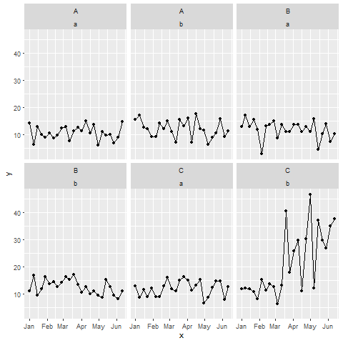
RESULTS
l

Slide 26
CALLING SAS FROM R USING KNITR AND MARKDOWN

Slide 27
WHAT IS KNITR?
knitr is an R package which combines code, comments, text and results into one document.
You write a document with text and code chunks.
knitr will run the code chunks and incorporate the results, knitting them into a single document.
This document can be in Word, HTML or PDF (the latter requires outside software).

Slide 28
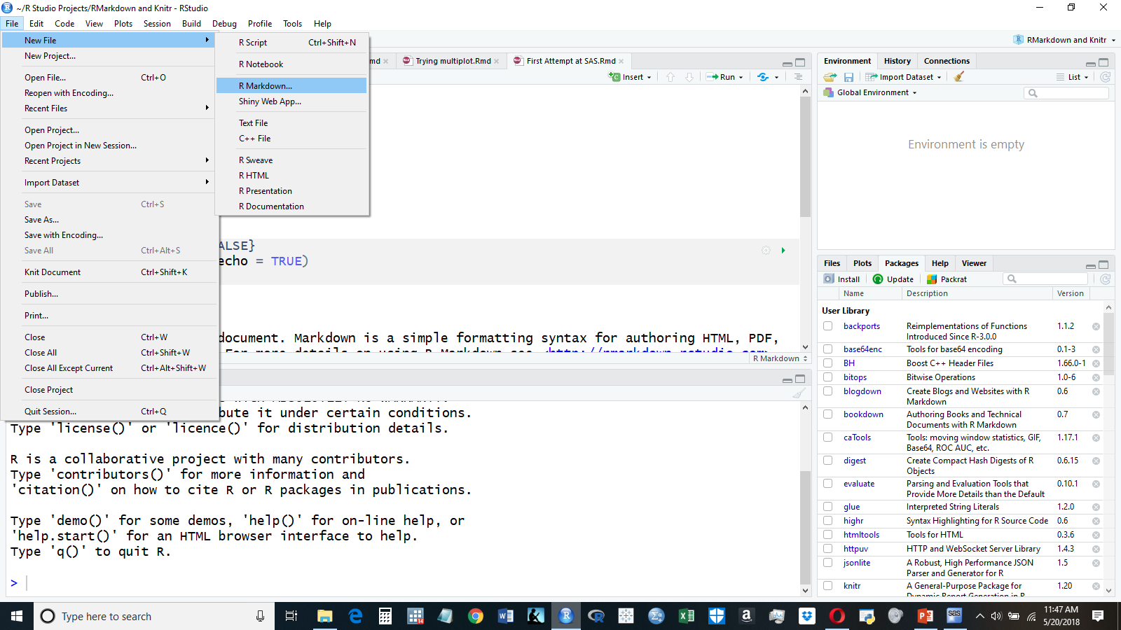
STARTING OFF – IN RSTUDIO

Slide 29
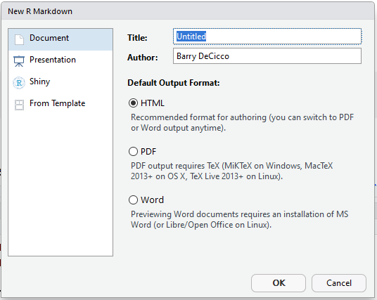
THREE OUTPUT OPTIONS
HTML – easiest to start with.
Word – generates rtf file.
PDF – this requires external software to finish, but gives you great results (with effort!). I l use HTML

Slide 30
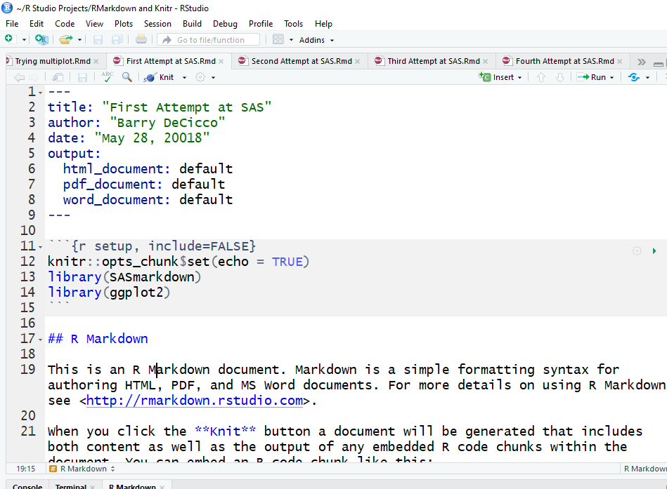
STARTING THROUGH THE DOCUMENT
Knitr will set up a standard starting document prepopulated with some items.
Title information.
Initial setup.
Explanation

Slide 31
LIMITATIONS
Each code chunk runs a separate batch job in SAS. There is no hand-off of WORK. data sets between SAS code chunks. (‘work’ is a temp folder for SAS).
To hand off data sets (between SAS and SAS, or SAS and R), save them as permanent files.
SAS HTML output plays well with knitr’s HTML markdown. For other types of output, other packages are needed.
Slashes/back-slashes in path names need to be managed – r uses forward slashes (/).

Slide 32
SET UP
Let R know that it’s using sas (the ‘SAS’ or ‘SASHTML’ engine).
Tell R where the SAS.exe file is.
Set any SAS options.
These can by done either by chunk overall.

Slide 33
SET UP
There are at least 20 ‘engines’ available for knitr, meaning 20 languages.
For SAS, there is the ‘sas’ and ‘sashtml’ engines. The latter plays nicely with knitr’s html output.
For this presentation, the ‘sashtml’ engine will be used. SAS will give output in HTML.

Slide 34
SET UP
There are at least 20 ‘engines’ available for knitr, meaning 20 languages.
For SAS, there is the ‘sas’ and ‘sashtml’ engines. The latter plays nicely with knitr’s html output.
For this presentation, the ‘sashtml’ engine will be used. SAS will give output in HTML.

Slide 35
Whole Document

Slide 36
Whole Document
In knitr, a set-up chunk is used to start the document, defining certain options.
Those options hold for all chunks, unless overwritten within a chunk.
For this method, the set-up chunk will set SAS as the option, and provide needed information.
This makes all chunks run SAS.

Slide 37
SETTING UP SAS IN THE SET-UP CODE CHUNK
```{r setup, include=FALSE}
library(SASmarkdown)
saspath <- "C:/Program Files/SASHome/SASFoundation/9.4/sas.exe"
sasopts <- "-nosplash -linesize 75"
knitr::opts_chunk$set(engine="sashtml",
engine.path=saspath,
engine.opts=sasopts,
comment=NA,
echo = TRUE)
```
Gray items are ‘code chunks’, where there is code to be executed.
They start and end with ```
This r command loads the library ‘SASMarkdown’, to integrate output.
This sets up SAS in this code chunk. It tells R to use SAS, and where SAS is.
This applies to the entire document.

Slide 38
RUNNING SAS
```{sas sas_1}
proc means data=sashelp.class;
run;
proc freq data=sashelp.class;
tables sex;
run;
```
At this point each code chunk will be sent to SAS by Rstudio, as a batch file.
The part which says ‘sas’ tells RStudio that this is for SAS.
‘sas_1’ is the name of the code chunk; they must be unique.

Slide 39
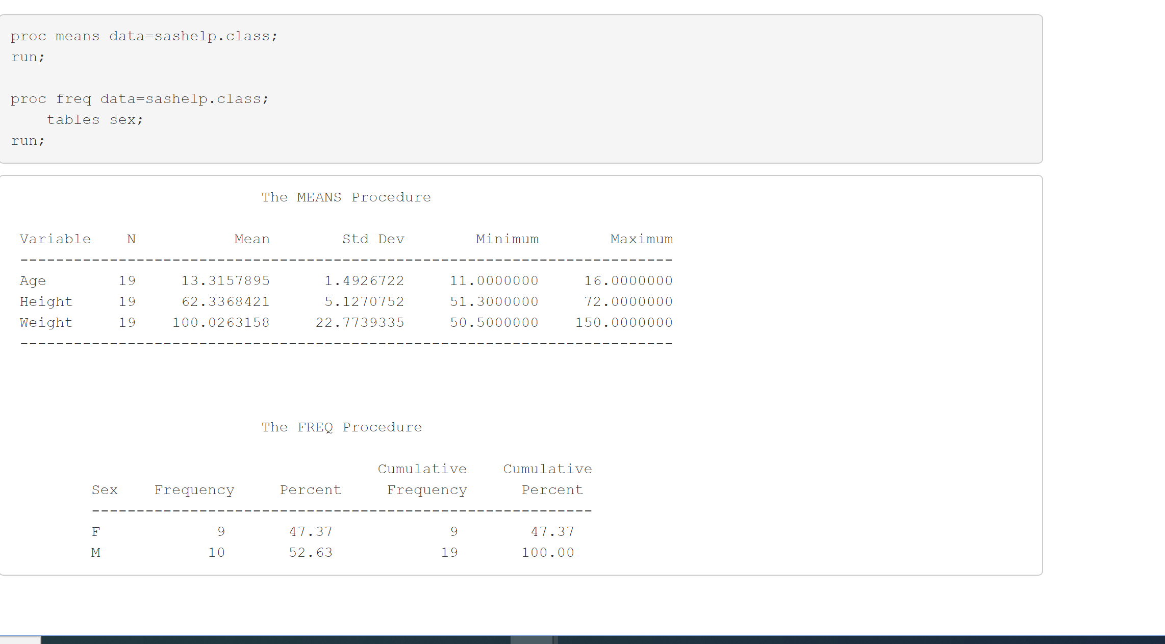
RESULTS

Slide 40
RUNNING SAS BY CHUNK

Slide 41
RUNNING SAS BY CHUNK
The setup chunk is a normal chunk for R, with the addition of the ‘SASmarkdown’ library.
```{r setup, }
library(SASmarkdown)
library(ggplot2)
```

Slide 42
RUNNING SAS BY CHUNK
```{chunk1, engine='sashtml', engine.path="C:/Program Files/SASHome/SASFoundation/9.4/sas.exe", engine.opts="-nosplash -linesize 75"}
proc means data=sashelp.class;
run;
proc freq data=sashelp.class;
tables sex;
run;
```
The name of the chunk is ‘chunk1’. Chunk names must be unique.
The information about SAS is provided in each code chunk which is to be run with SAS.
SAS commands

Slide 43
RUNNING SAS
```{sas sas_1}
proc means data=sashelp.class;
run;
proc freq data=sashelp.class;
tables sex;
run;
```
At this point each code chunk will be sent to SAS by Rstudio, as a batch file.
The part which says ‘sas’ tells RSTudio that this is for SAS.
‘sas_1’ is the name of the code chunk; they must be unique.

Slide 45
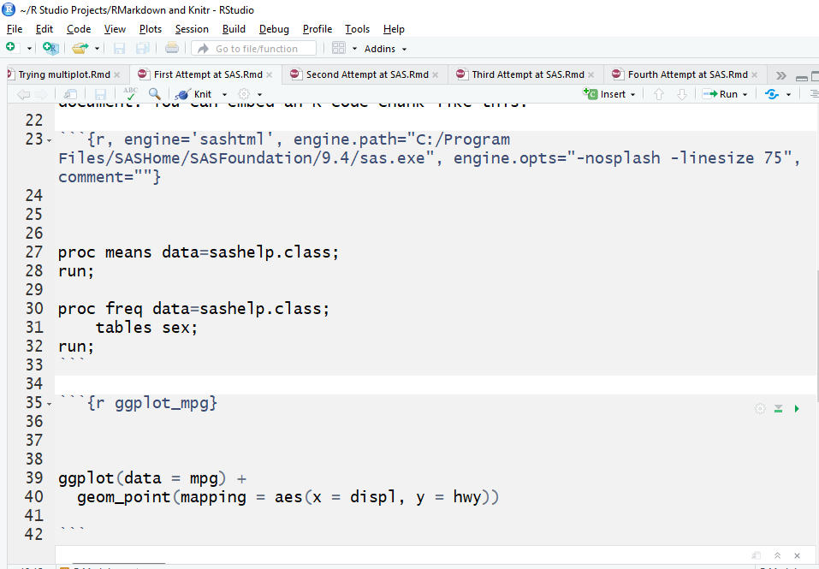
SETTING UP SAS IN A CODE CHUNK
Gray items are ‘code chunks’, where there is code to be executed.
They start and end with ```
This sets up SAS in this code chunk. It tells R to use SAS, and where SAS is.
This applies *only* to this chunk.

Slide 46
SETTING UP SAS IN A CODE CHUNK
Gray items are ‘code chunks’, where there is code to be executed.
They start and end with ```
This sets up SAS in this code chunk. It tells R to use SAS, and where SAS is.
This applies *only* to this chunk.

Slide 47
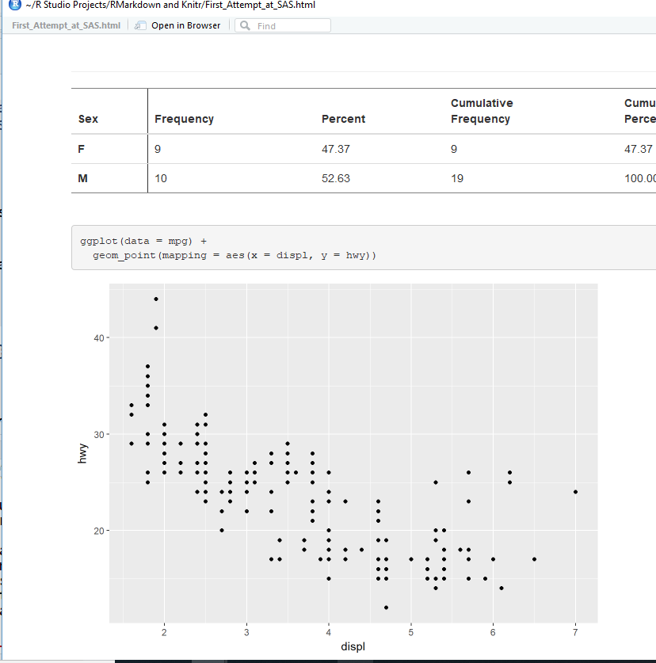
RUNNING SAS
Once the set up has been done SAS commands can be done in one chunk, with r commands in another.

Slide 48
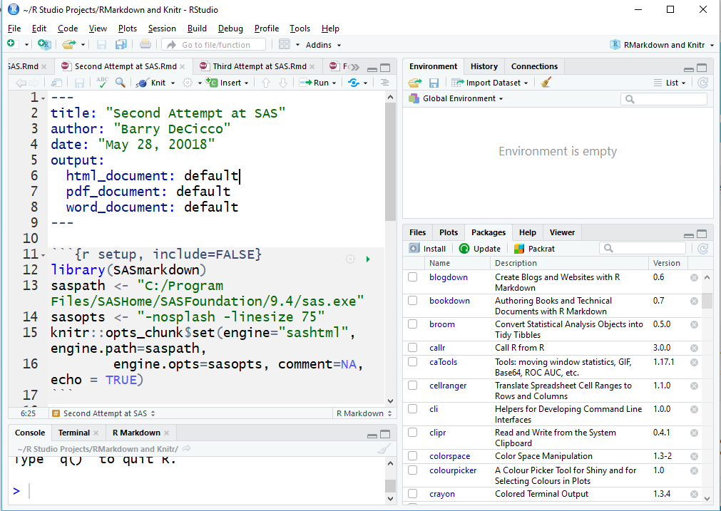
IMPORTANT NOTE ON THE SETUP CHUNK
Setting the SAS option in the setup code chunk will cause knitr means to run *all* code chunks in the document with SAS.

Slide 49
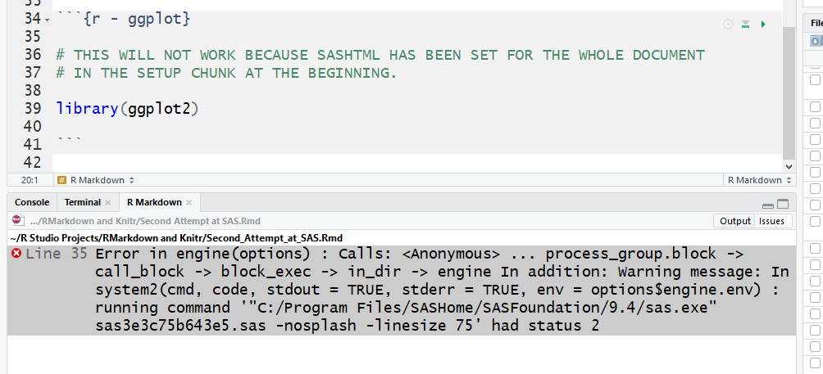
IMPORTANT NOTE ON THE SETUP CHUNK
Setting the SAS option in the setup code chunk will cause knitr means to run *all* code chunks in the document with SAS.

Slide 50
Questions?

Slide 51
Appendices
Appendix A: SAS Documentation
Appendix B: R Documentation
Appendix C: How to get a copy

Slide 52
Appendix A: SAS Documentation
SAS/IML(R) 9.3 User's Guide ‘The RLANG System Option’ http://support.sas.com/documentation/cdl/en/imlug/64248/HTML/default/viewer.htm#imlug_r_sect003.htm
SAS/IML(R) 9.3 User's Guide‘Submit R Statements’ http://support.sas.com/documentation/cdl/en/imlug/64248/HTML/default/viewer.htm#imlug_r_sect004.htm

Slide 53
Appendix A (con):
SAS/IML(R) 12.1 User's Guide: EXPORTDATASETTOR Call http://support.sas.com/documentation/cdl/en/imlug/65547/HTML/default/viewer.htm#imlug_langref_sect114.htm
SAS/IML(R) 12.1 User's Guide: IMPORTDATASETFROMR Call http://support.sas.com/documentation/cdl/en/imlug/65547/HTML/default/viewer.htm#imlug_langref_sect182.htm

Slide 54
Appendix A (con):
‘Run R code inside SAS easily’ SAS/IML(R) 9.3 User's Guide ‘EXPORTDATASETTOR Call’ http://support.sas.com/documentation/cdl/en/imlug/65547/HTML/default/viewer.htm#imlug_langref_sect114.htm
SAS Blogs: Video: Calling R from the SAS/IML Language https://blogs.sas.com/content/iml/2011/10/31/video-calling-r-from-the-sasiml-language.html

Slide 55
Appendix B: R Documentation
‘SAS Using R Markdown (Windows)’ https://www.ssc.wisc.edu/~hemken/SASworkshops/Markdown/SASmarkdown.html#html-or-pdf-document-as-a-final-target
The raw markdown version of the above page: https://www.ssc.wisc.edu/~hemken/SASworkshops/Markdown/SASmarkdown.rmd
‘Tables and Graphs - Using the sashtml Engine’ https://www.ssc.wisc.edu/~hemken/SASworkshops/Markdown/SAShtmlengine.html
Dynamic Documents with R and Knitr (by Yihui Xie) https://yihui.name/knitr/

Slide 56
Appendix C: How to get a copy
This presentation is stored on GitHub: https://github.com/BarryDeCicco/SASandRandSAS
It is currently private but should be set to public very soon.

